Slide 1

BookMyMovie
Web Programming Final Project
Harish Kunta
002-54-2576

Slide 2
Contents
Overview
Technology Stack
FlowChart
Functionality
Screenshots
Database Design
Software Development Life Cycle
Future Scope
References

Slide 3
Overview:
BookMyMovie is an online ticketing service for booking movies.
It includes admin functionality to manage the application.
The website is designed in HTML,PHP, JS and CSS as per the requirement specified in the project.

Slide 4

Technology Stack
HTML
CSS
PHP
Java Script
Boot Strap
SQL
XAMPP
Visual Studio

Slide 5
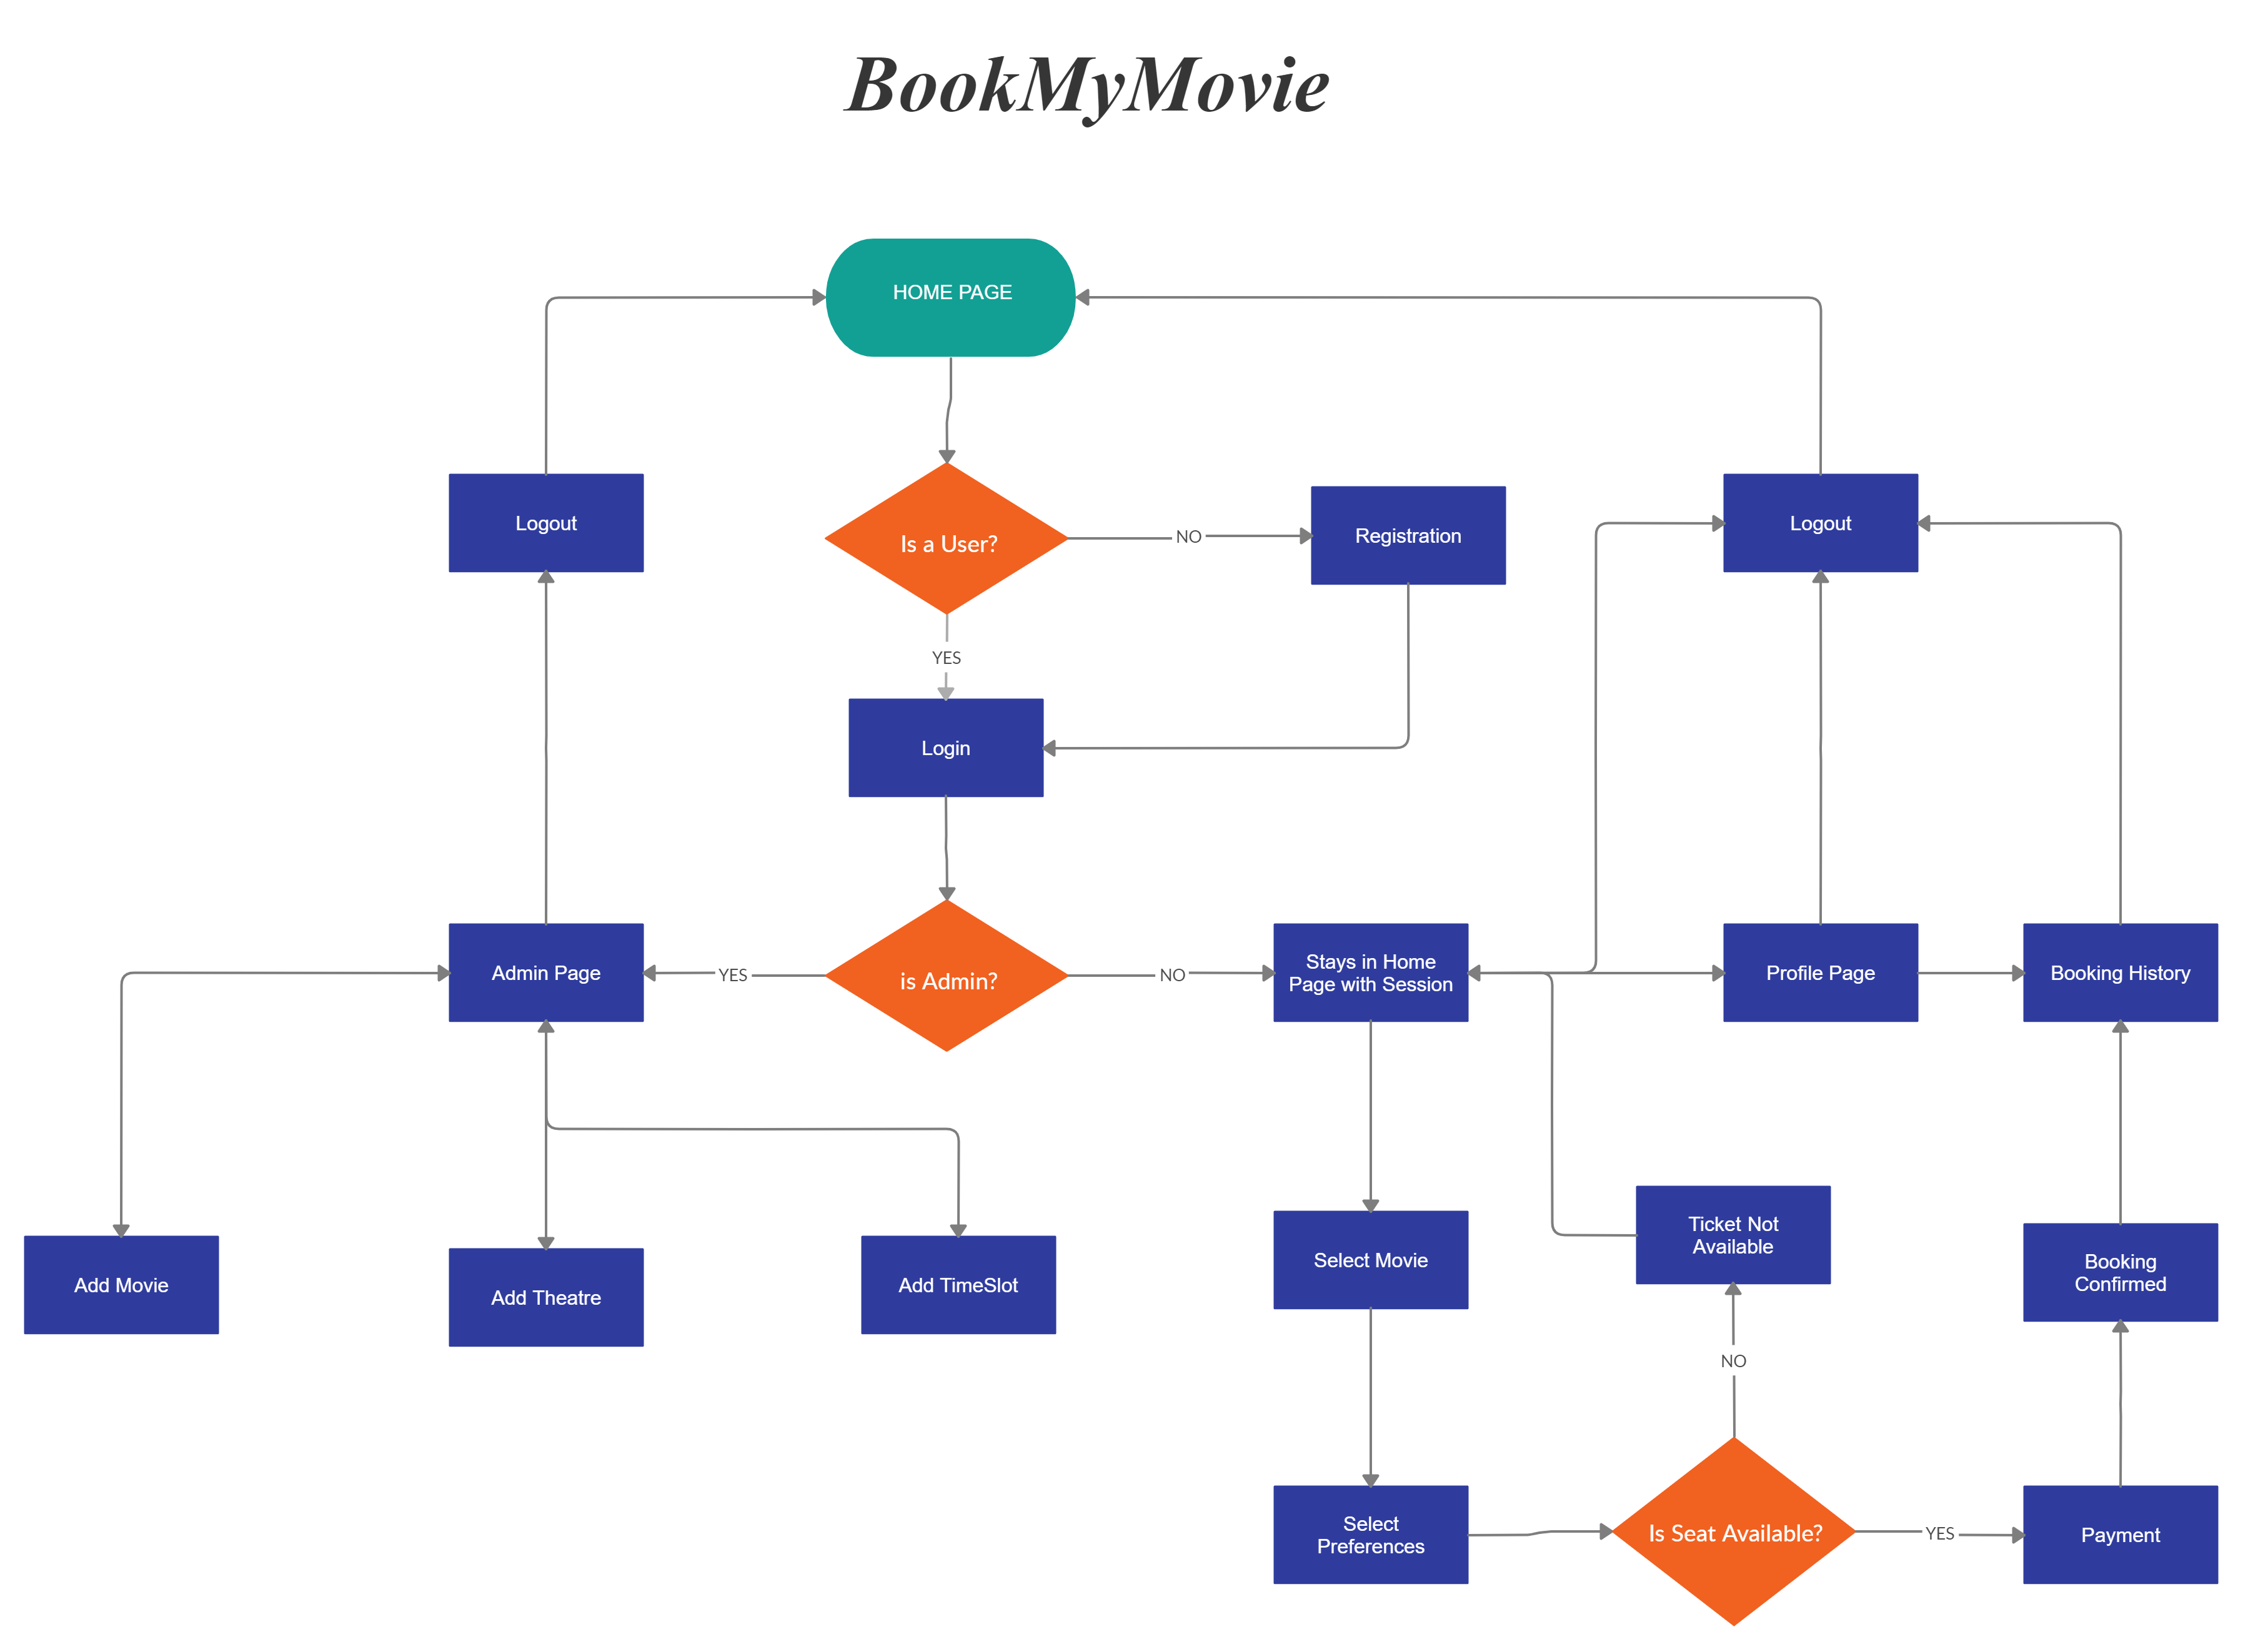
FlowChart

Slide 6
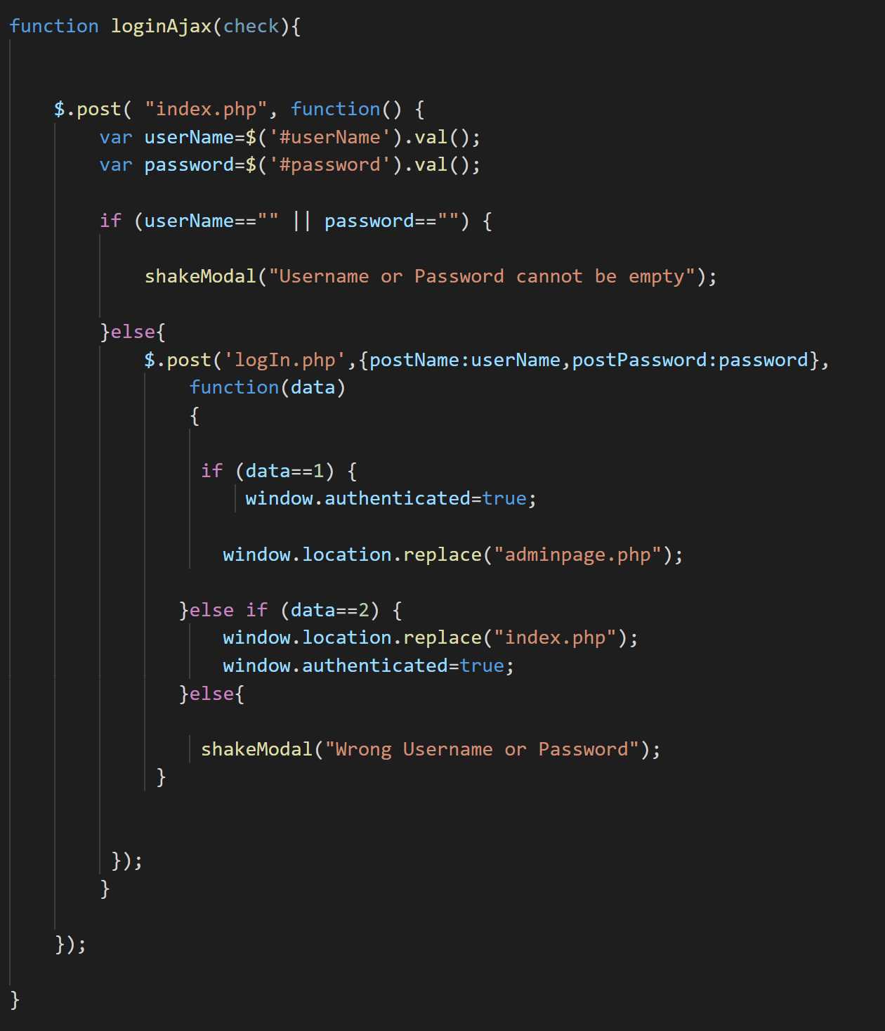
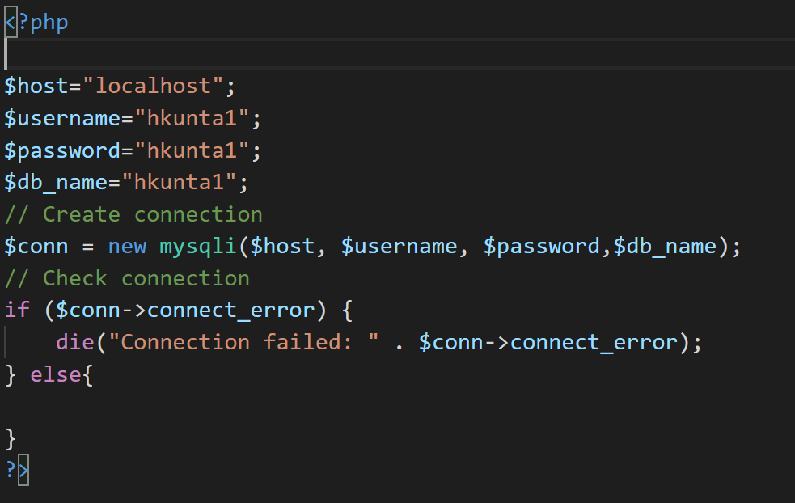
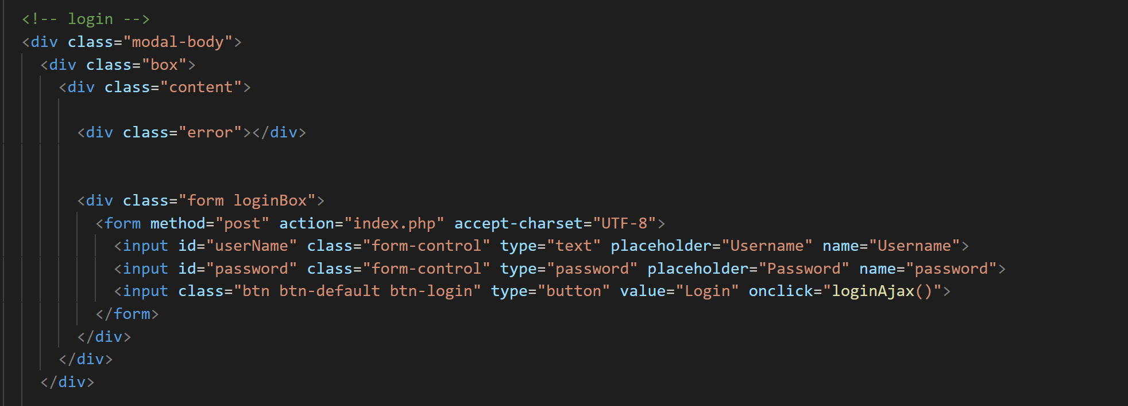
Code Snippets

Slide 7
Functionality
Login : User and Admin can login to the application using their credentials.
Registration : New users can create an account in the application by providing their details.
Browsing Movies : Users can browse the movies showing now in the home page by applying filters based on Genre: Action, Drama, Comedy etc.
Movie Details : Details like movie description, IMDB rating, Genre and Director name can be viewed by hovering over the movie icon in Home Page.
Booking a Ticket : Users can book a ticket by selecting their preferences like Date, Time, Location of the movie.
Payment Mode : Users will have the ability to purchase the ticket by using Debit Card, Credit card and PayPal.
Booking History: Users can view previously made purchases.
Ticket: Unique ticket will be generated for every booking made.
Admin Actions: Admin has the access to Add Movie, Add Theatre and Add Time Slot.

Slide 8
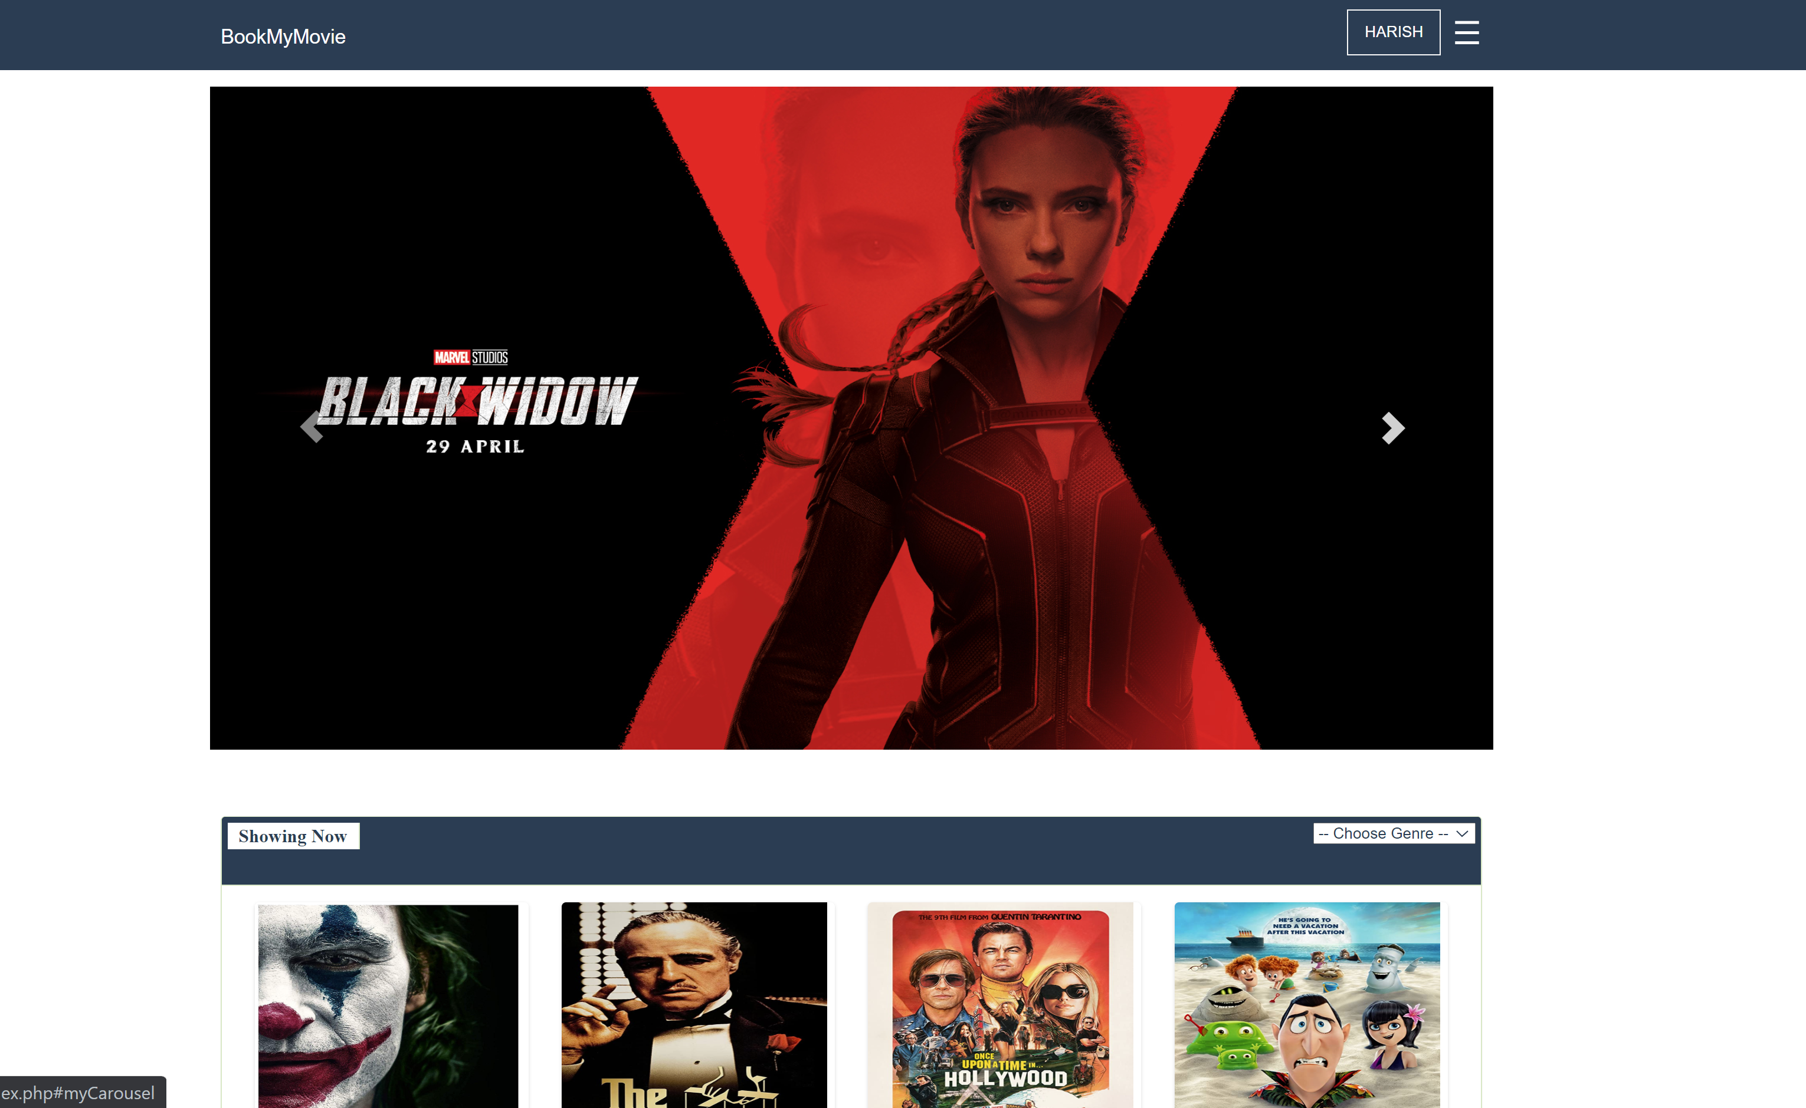
Home Page
Home Page contains list of all the movies that are screening now.
Users can filter the movies based on the Genre:
Action
Adventure
Crime
Drama
Comedy
User can also navigate to Profile page, Bookings History page using Side Navigation bar.
User can Logout by selecting logout in Side Navigation bar.

Slide 9
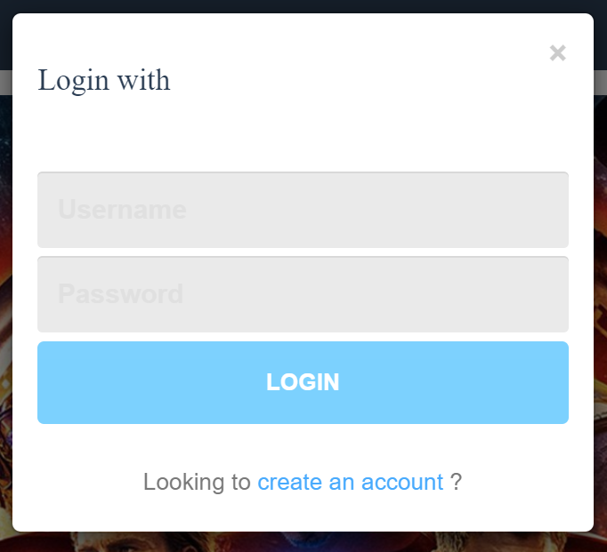
Login Page
User can login by providing his credentials and clicking on login button.
If he doesn’t have an account he can create one by clicking on “create an account” link

Slide 10
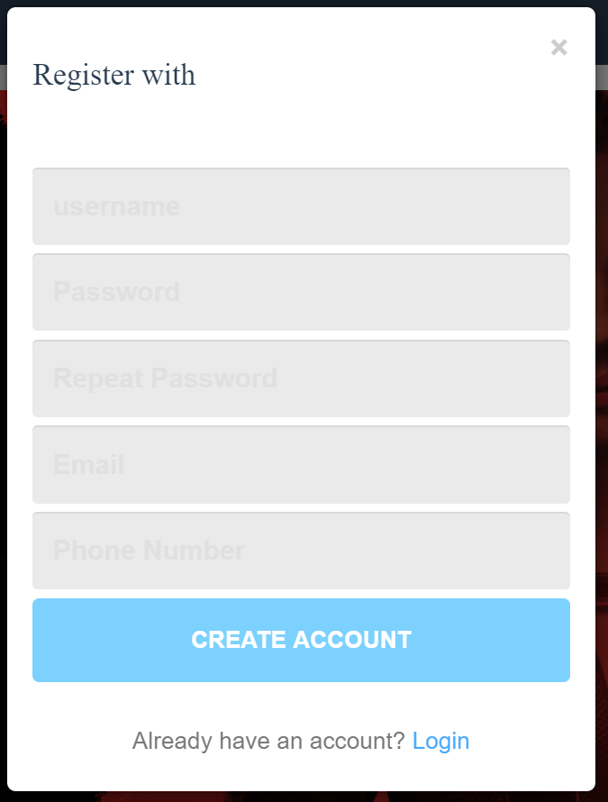
Registration Page
Users can register into the website by submitting their details in Registration Page and clicking on “Create Account” Button.
Else user can go back to Login Page by clicking on “Login” link.

Slide 11
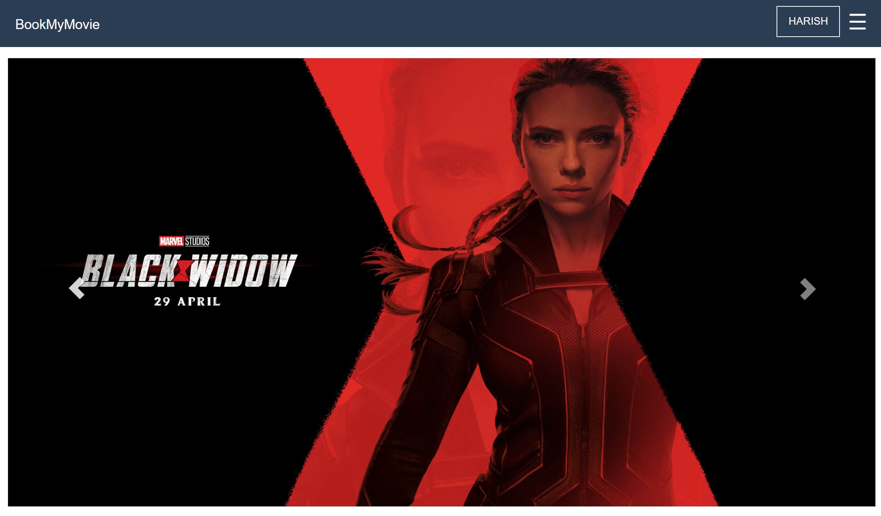
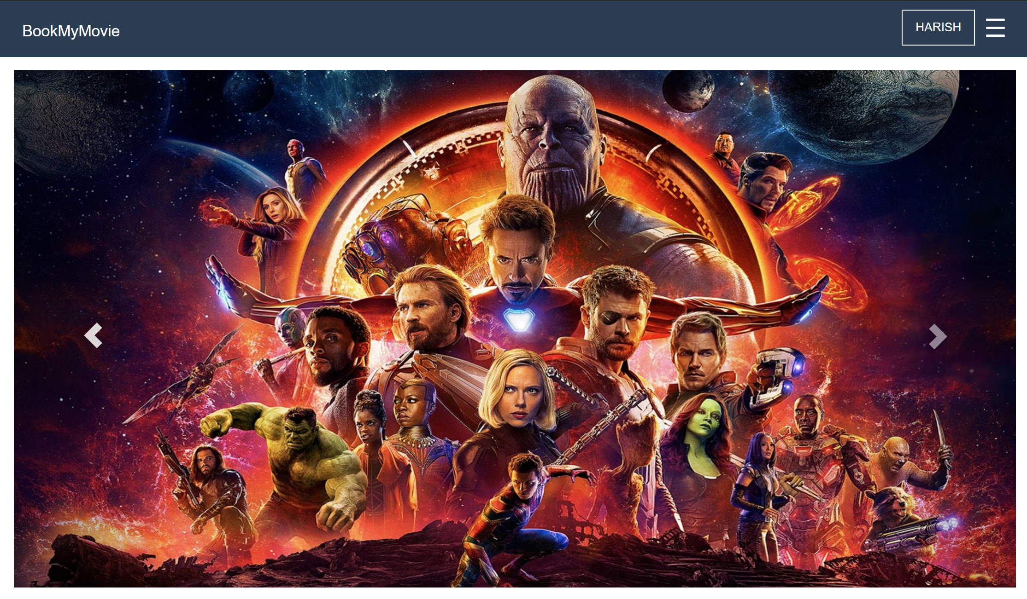
CSS Styles:
Sliding Poster: The poster image will change every 5 seconds cycling through a set of images

Slide 12
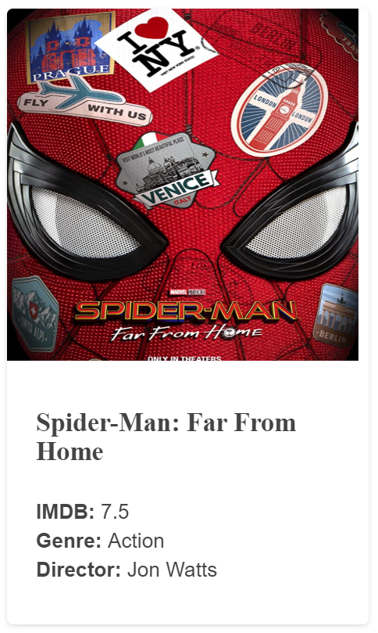
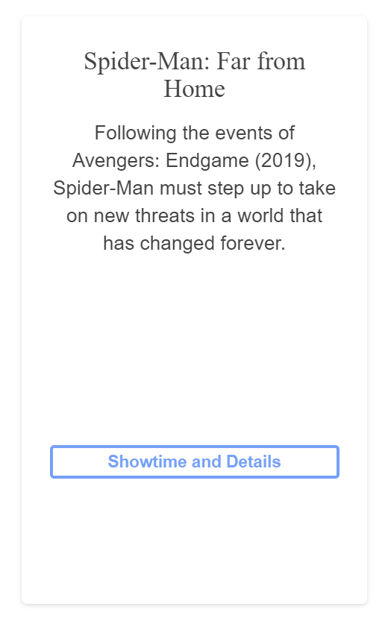
CSS Styles:
Flipping Views: user can select the movie by hovering over the movie icon
Before Hover: After Hover:

Slide 13
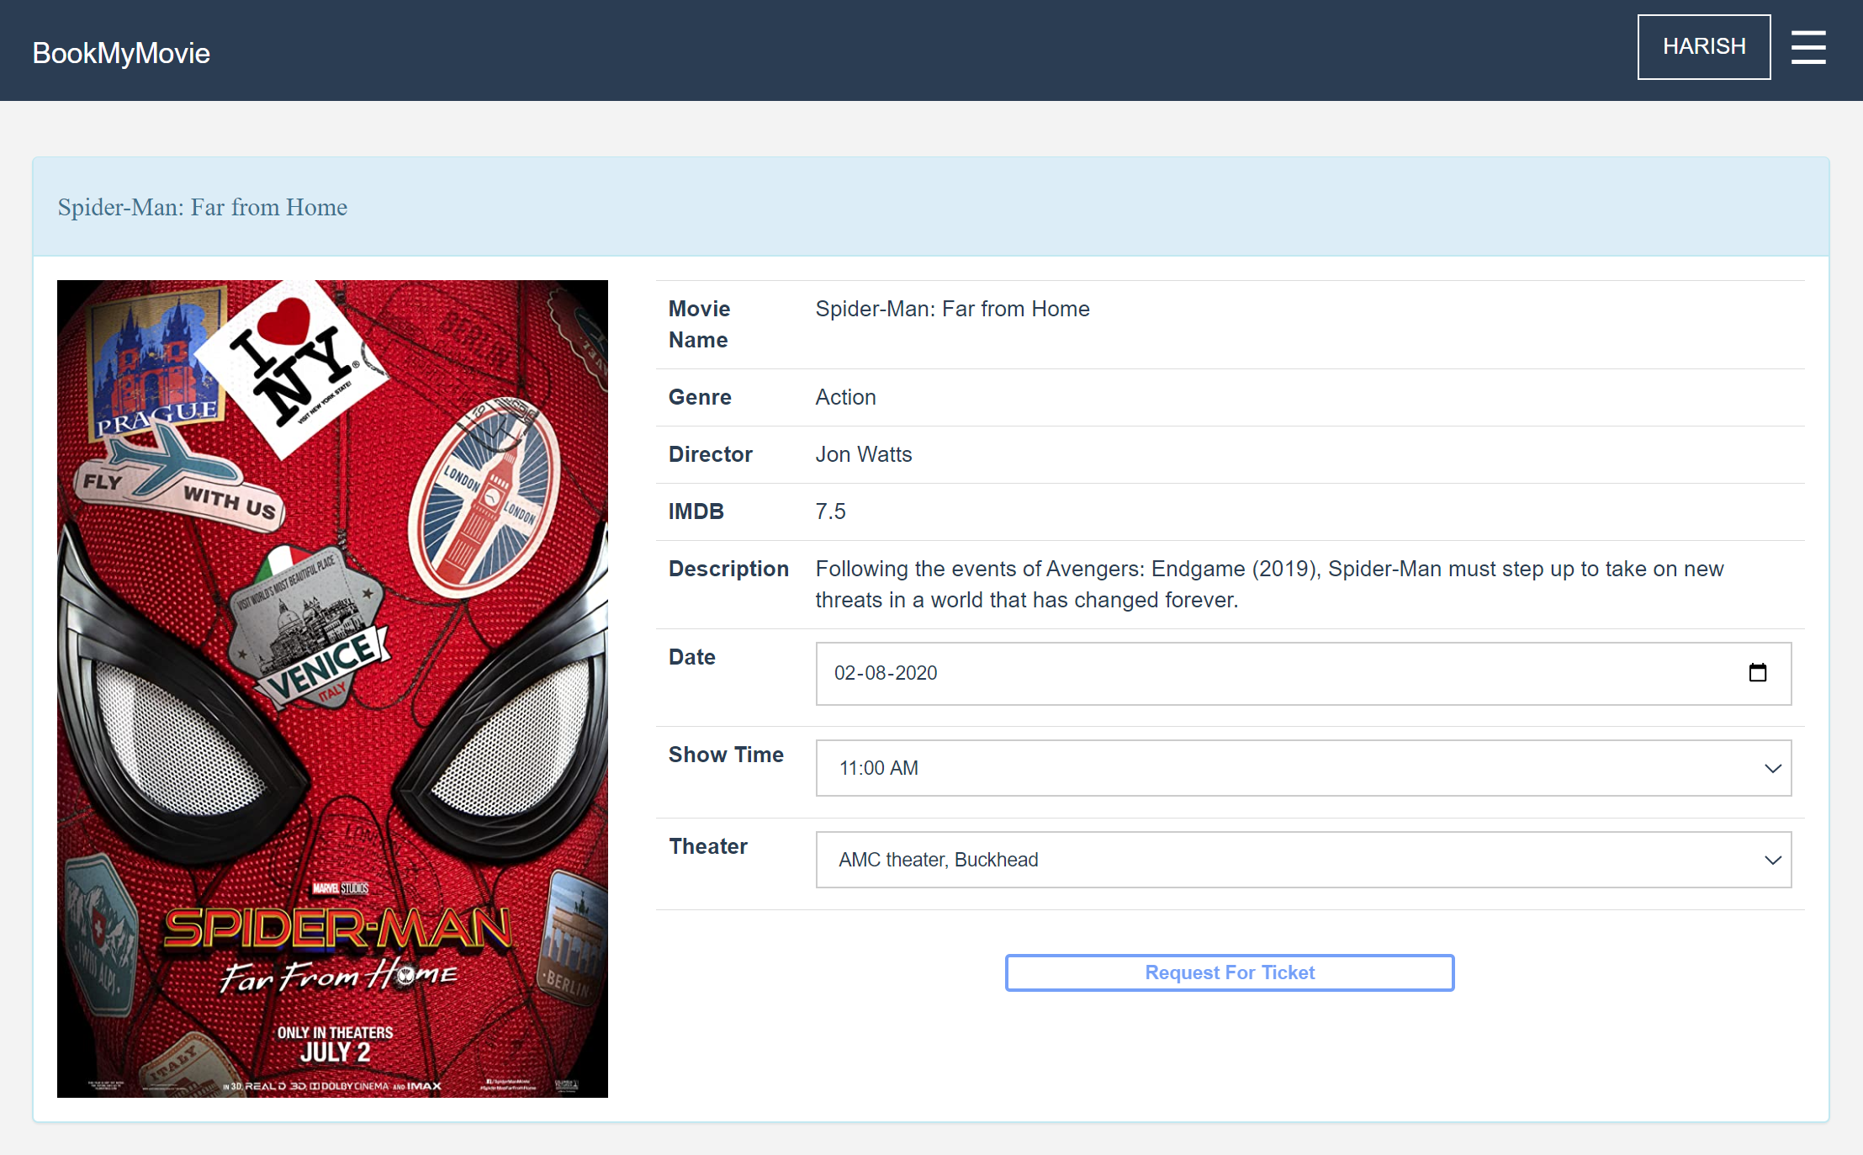
Preferences Page:
In this Page Users can select the preferred date ,time and location for booking the movie ticket.
Users then clicks on “request for ticket” button to check for availability of the ticket.

Slide 14
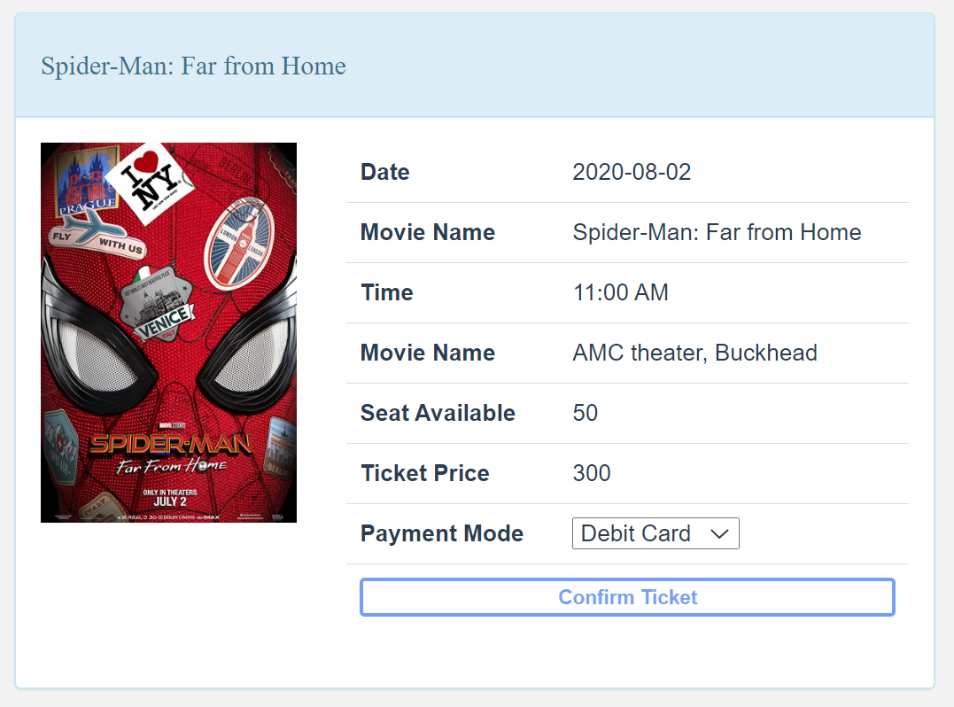
Payment Page:
In this page user needs to select the payment method using the drop down provided.
He can pay using:
Debit Card
Credit Card
PayPal
Then user clicks on Confirm ticket Button.

Slide 15
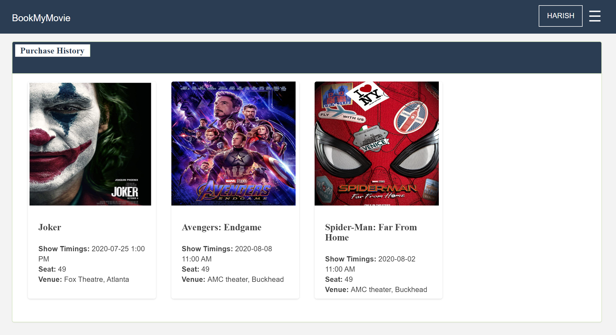
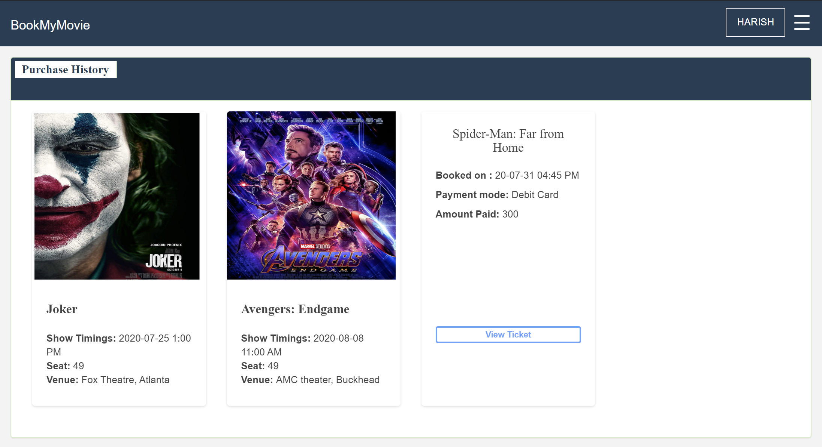
Purchase History:
Before Hover:
In this page user can see the details of the previous bookings including Show Timings, Seat number, Venue, Payment mode and amount paid.
This page contains movies with flipping views.
User needs to hover over the booking item and click on View Ticket to open ticket.
After Hover:

Slide 16
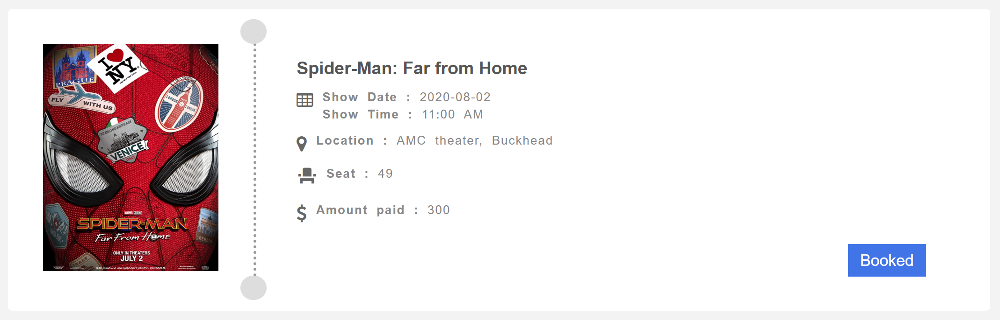
Movie Ticket:
This page contains the actual movie ticket with details:
Movie Name
Show Date and Time
Location
Seat Number
Amount Paid

Slide 17
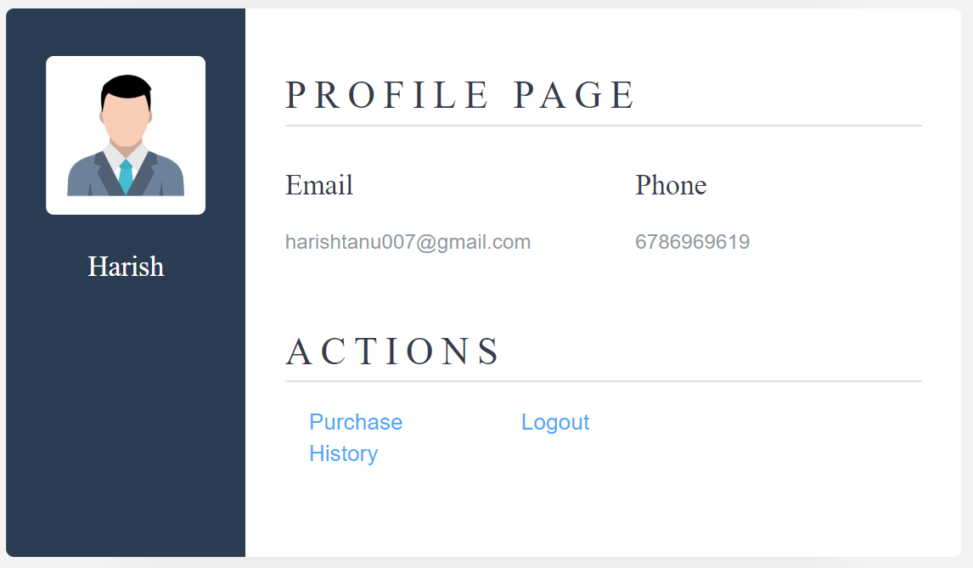
Profile Page:
In this page user can view his personal Details:
Username
Email
Phone number
User can View the booking history by selecting the “Purchase History” Button.
User can also Logout by selecting the “Logout” Button.

Slide 18
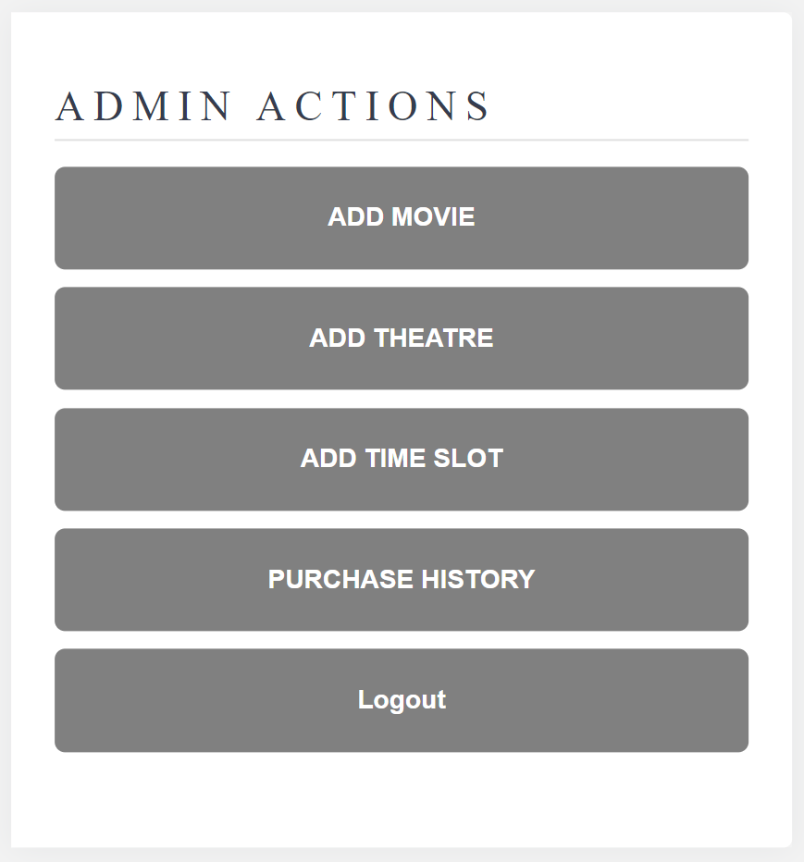
Admin Page:
This page will be accessed only by admin.
The Actions performed by admin are:
Add a movie
Add a theatre
Add time slot
Purchase History
For verifying if the Movie got added successfully, admin can also view and book tickets in the website as a normal user.

Slide 19
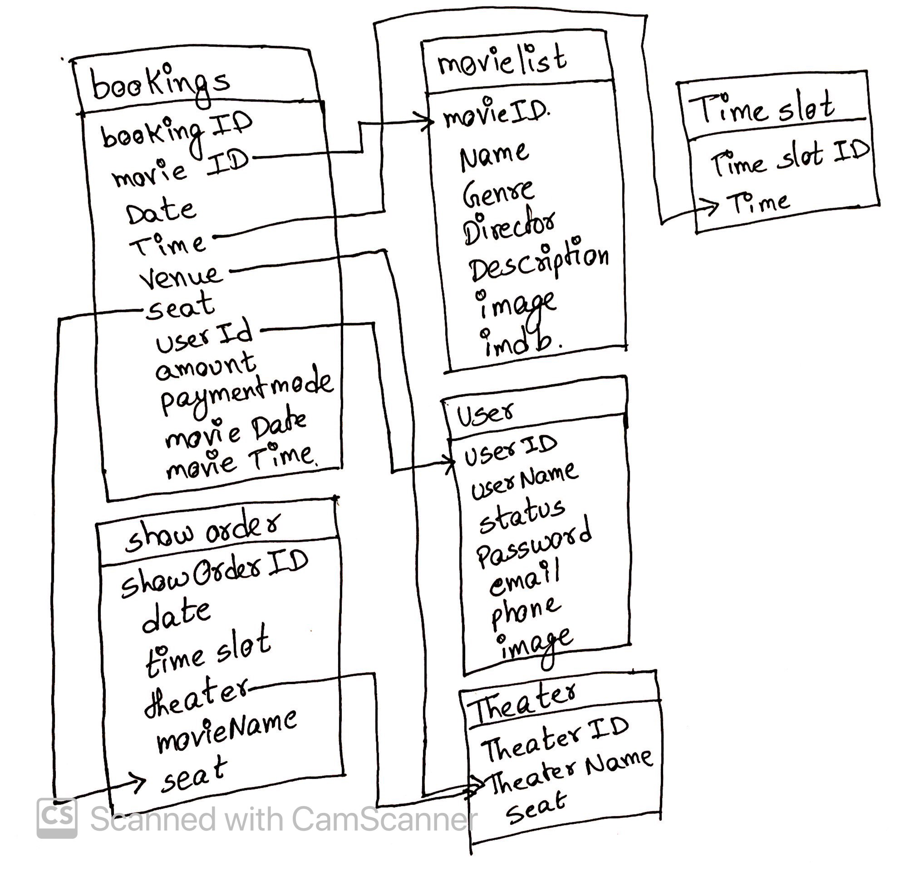
Database Design

Slide 20
Tables:
Movie Table
Bookings Table
Seat Availability Table
Theaters Table
Time slot Table
Users Table

Slide 21
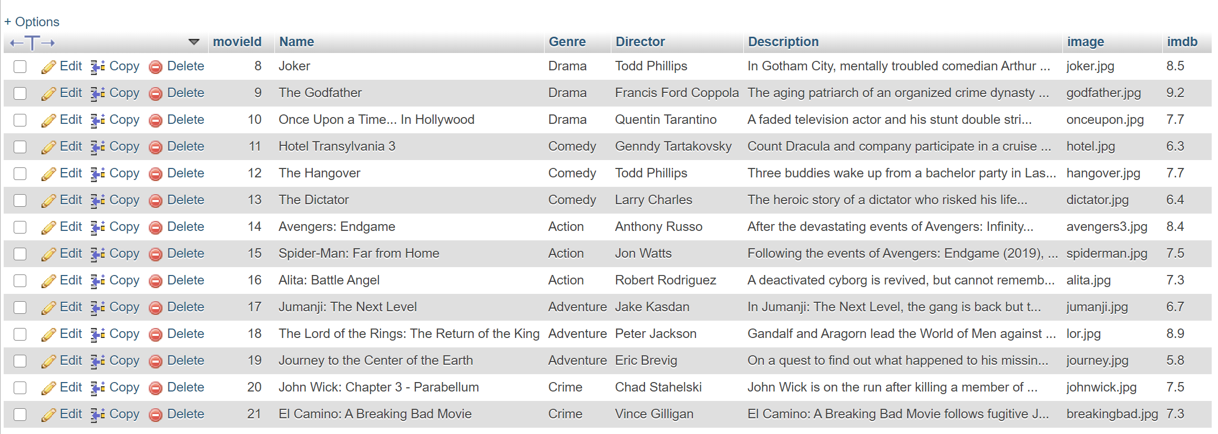
Movie Table

Slide 22
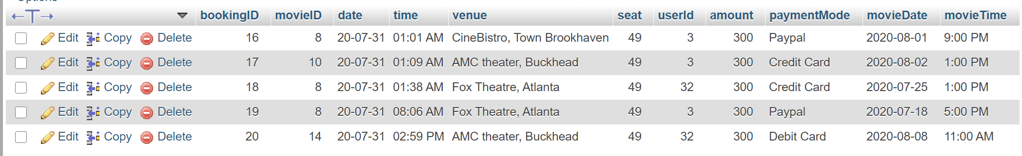
Bookings Table

Slide 23
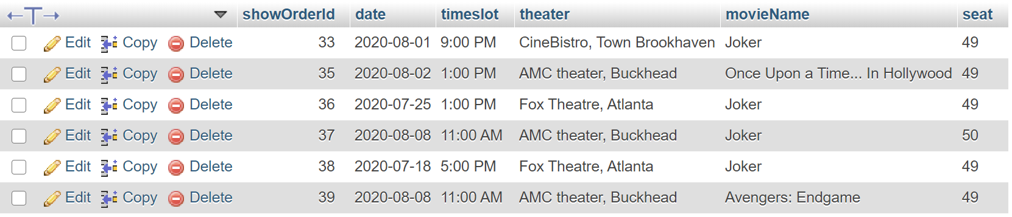
Seat Availability Table

Slide 24
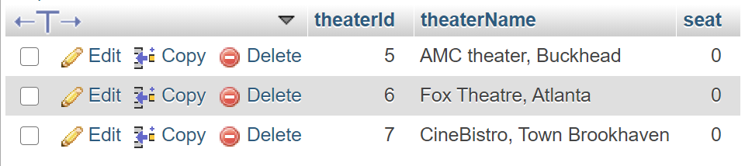
Theaters Table

Slide 25
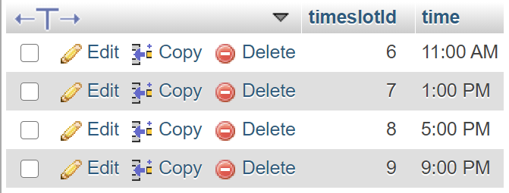
Time Slot Table

Slide 26
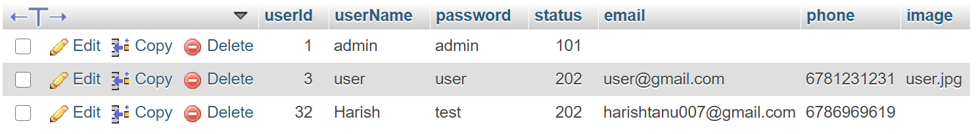
Users Table

Slide 27

SDLC
Requirement Analysis
Design
Implement
e
Testing
Deployment

Slide 28
Future Scope
Payment Integration
Email Authentication
Multiple Tickets

Slide 29
References
CODD link:
https://codd.cs.gsu.edu/~hkunta1/BookMyMovie/index.php
Github:
https://github.com/harishtanu007/BookMyMovie

Slide 30


